Slide 1
Ladybird Beetles in Different Temperature Conditions
Raghav Arora, Dom Demas, Maddie Willett
Cal Poly MSBA
2/22/23

Slide 2
Problem Statement
Which model best fits the distribution of ladybirds beetles in different temperature conditions

Slide 3
Preview of Results
Model | Adjusted R² | RSE
Linear | 0.1169 | 12.38
Quadratic | 0.5814 | 8.523
Cubic | 0.7341 | 6.793
Quartic | 0.7587 | 6.471
The Quartic model best fits the distribution!

Slide 4
Background Review
Article published about:
ladybird beetles’ behavior as temperature changes
Experiment ran:
Changing temperature conditions
How many beetles stayed in the light?
Problem:
Need model that best fits distribution
Source: Ladybird Beetles in Different Temperature Conditions

Slide 5
Data Description
Dataset with 2 columns:
Temp: the Temperature (celsius)
Lighted: number of beetles in the light
44 observations
Summary Statistic | Temp | Lighted
Mean | 11.89 | 50.16
Median | 8 | 49
Standard Deviation | 10.99 | 13.17

Slide 6
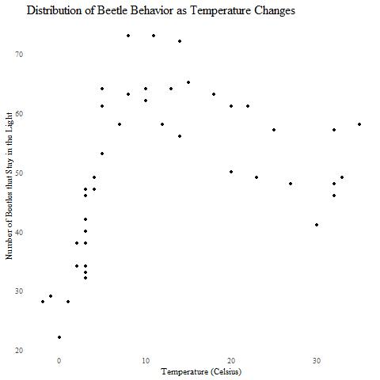
EDA: Dataset Distribution

Slide 7
Modeling Approach
Types of Models Analyzed:
Linear
Quadratic
Cubic
Quartic
Want: Model that fits data the best.
Highest Adjusted R²
Lowest RSE

Slide 8
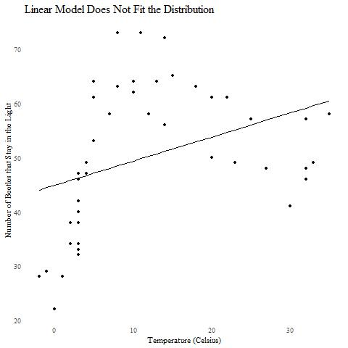
Model 1: Linear
Light = β0 + β1 Temp
Adjusted R² = 0.1169
RSE = 12.38

Slide 9
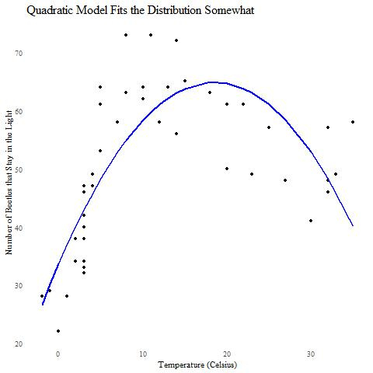
Model 2: Quadratic
Light = β0 + β1 Temp + β2 Temp
2
Adjusted R² = 0.5814
RSE = 8.523

Slide 10
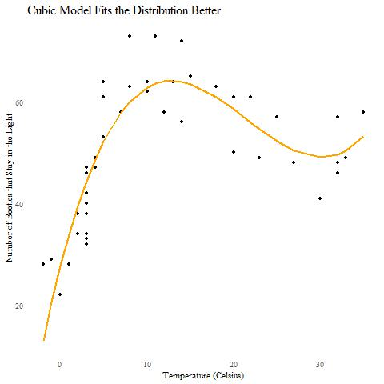
Model 3: Cubic
Light = β0 + β1 Temp + β2 Temp
+ β3 Temp
2
3
Adjusted R² = 0.7341
RSE = 6.793

Slide 11
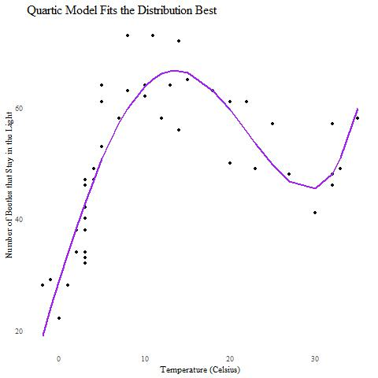
Model 4: Quartic
Light = β0 + β1 Temp + β2 Temp
+ β3 Temp + β4 Temp
2
3
4
Adjusted R² = 0.7587
RSE = 6.471

Slide 12
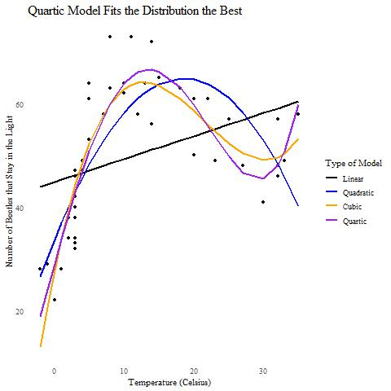
Results: Overview
Model | Adjusted R² | RSE
Linear | 0.1169 | 12.38
Quadratic | 0.5814 | 8.523
Cubic | 0.7341 | 6.793
Quartic | 0.7587 | 6.471

Slide 13
Possible Shortcomings and Problems
Multicollinearity
A problem when having products/powers in model
Solution
Center predictor variables
Standardize variables to mean 0, SD 1

Slide 14
Conclusion
Quartic Model fits data the best.
Highest Adjusted R²
Lowest RSE
Where next?
Higher polynomial models
Issues with overfitting

